Slide 1
Global Internet Users Name: Saurabh Pandey Registration No : 12017578 Evaluation: CA3 Roll no : 27 Course: INT233 Data Visualization

Slide 2
INTRODUCTION
This report presents the data visualization of the Global Internet Users dataset, which was obtained from Kaggle. The dataset contains information on the number of internet users in different countries around the world, as well as their corresponding populations. The purpose of this report is to provide an insightful analysis of the dataset through various charts, graphs, and tables.

Slide 3
Analysis on dataset
From the visualizations, it is evident that there has been a steady increase in the number of internet users globally, with a particularly rapid growth rate in developing countries. The data also shows that there is a strong correlation between a country's population size and the number of internet users, as well as between a country's income level and internet penetration rate.

Slide 4
I
Top 20 countries with most No. of Internet users:
In this visualization we will analyses the top 20 countries most no of Internet users.
We use colored bar chart for this visualization by filtering top 20 countries

Slide 5
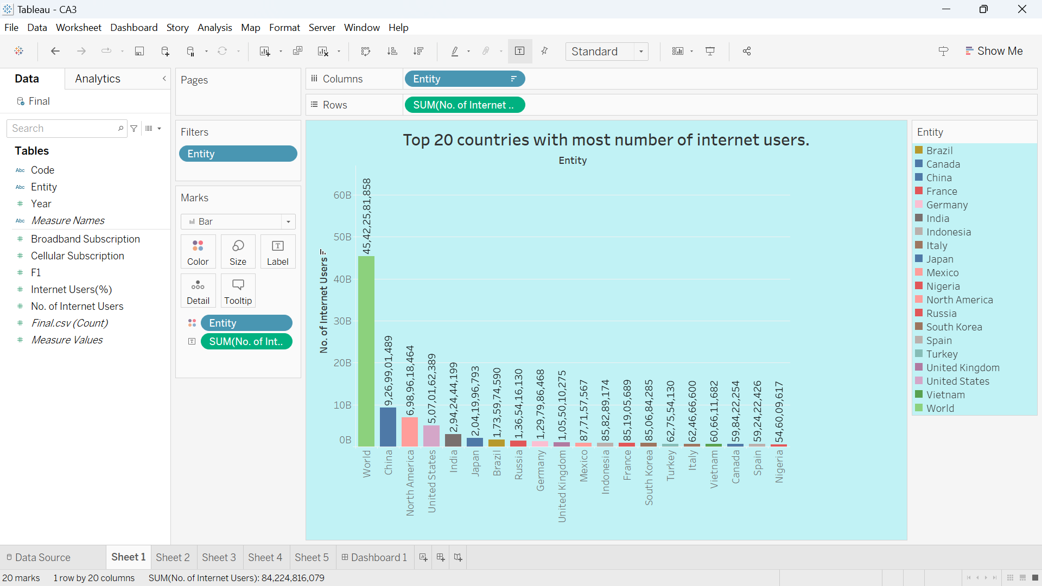

Slide 6
II
Top 20 countries with most no of cellular subscription.
In this visualization we will analyze top 10 countries with most no of cellular subscription.
We use horizontal bar chart in this wit top 10 filter.

Slide 7
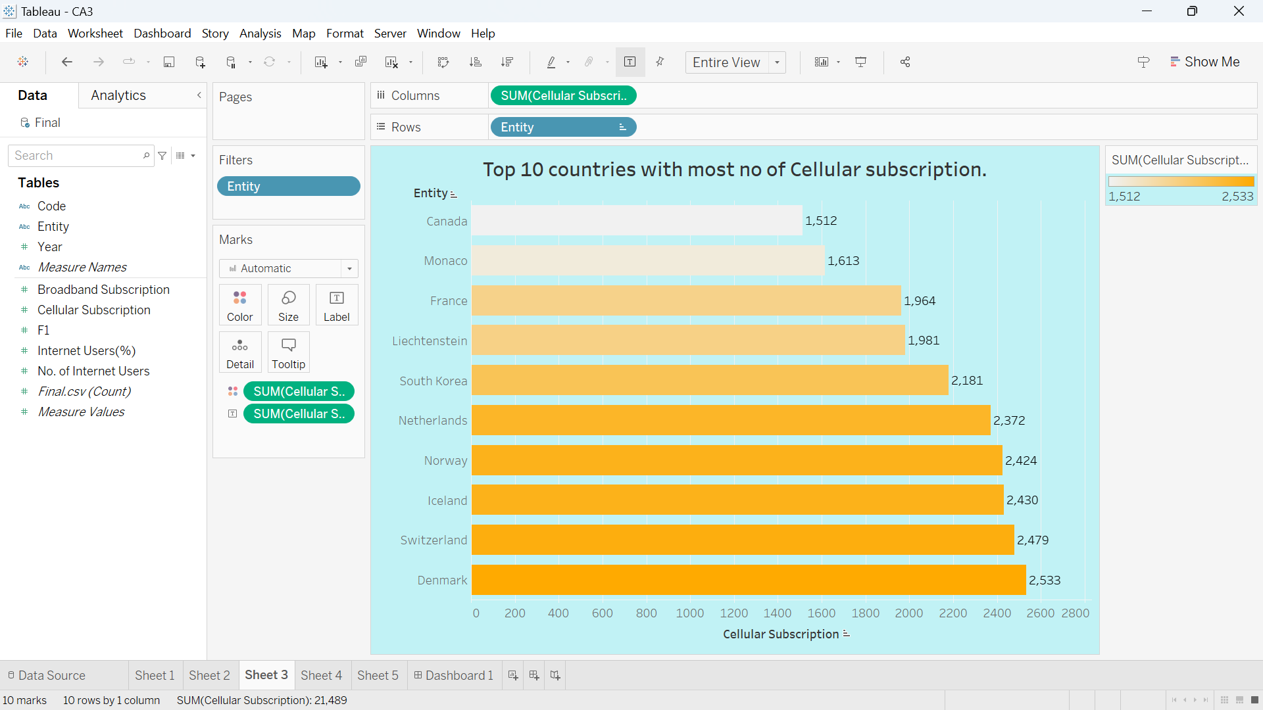

Slide 8
III
Percentage of Internet user each year.
In this visualization we will show that highest percentage of internet users is in 2017.and there so much hike in percentage of internet users by 2010.
We used Bubble chart for showing this analysis, various filters and quick table measures

Slide 9
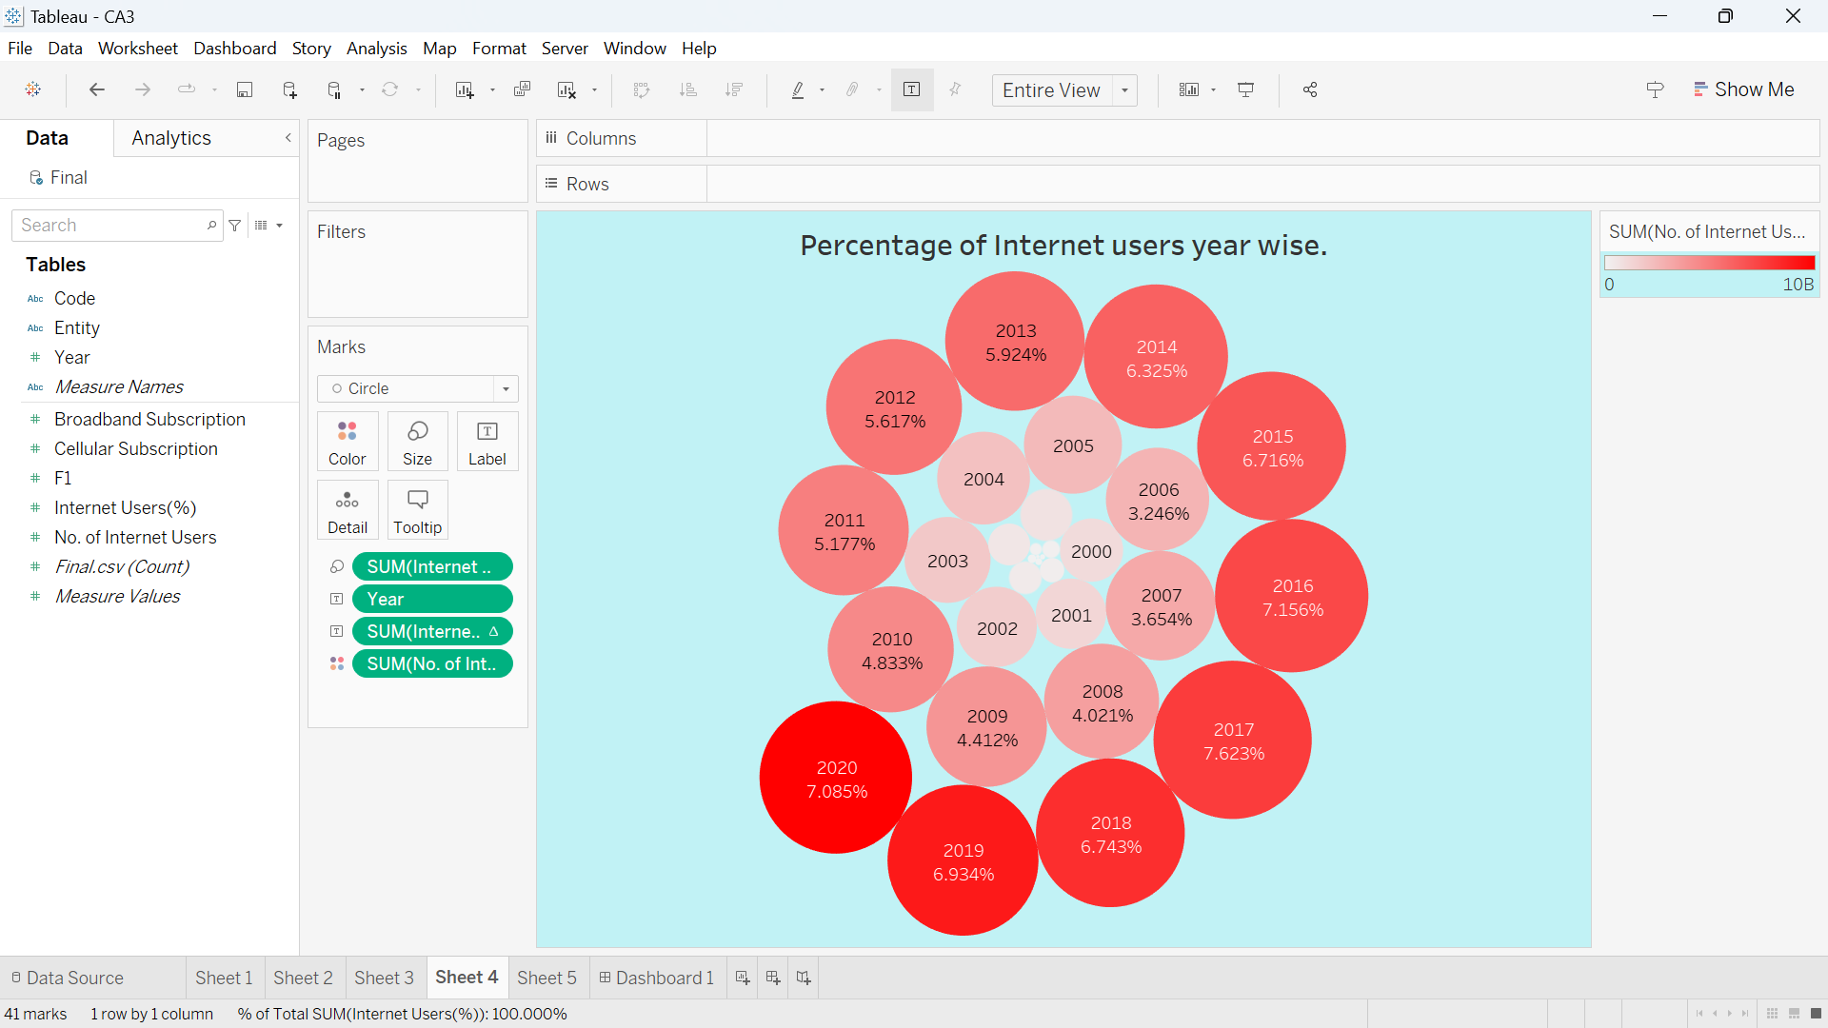

Slide 10
IV
Top 10 countries with most no of broadband subscriptions.
In this visualization we will talk about top 10 countries with most no. of broadband subscription, we can clearly say that Monaco is with most no. of broadband subscription.
We used pie chart to show this with top 10 filter and showing the percentage by using quick table calculations.

Slide 11
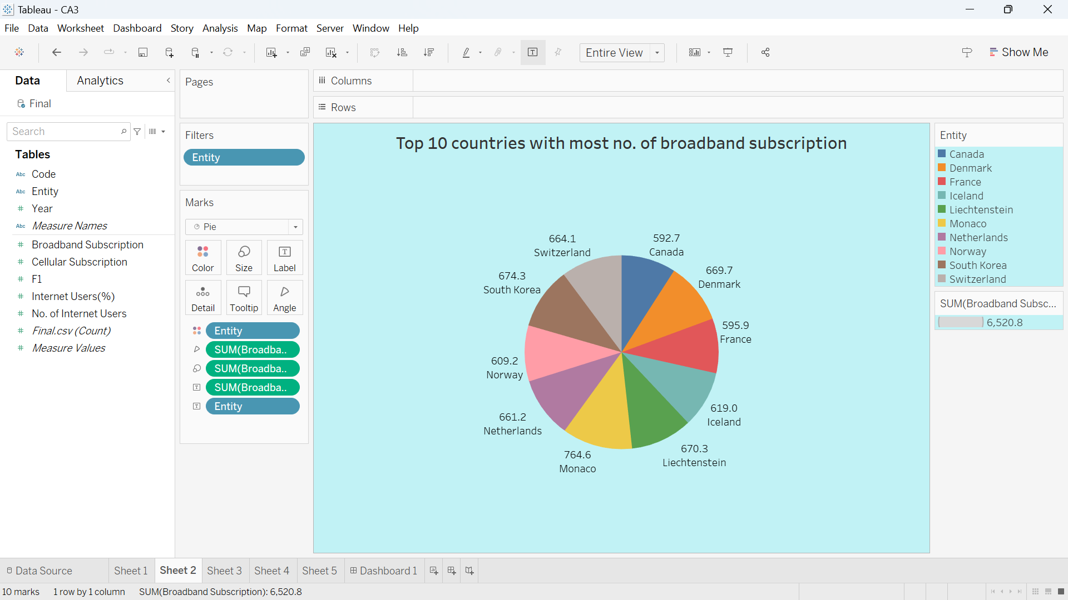

Slide 12
V
Most % of Internet users per year.
In this visualization we will show that most % of internet users per year, we can clearly see the hike from 2010 in each country and countries like India show exponential hike after 2013 onward.
We use Area chart with top 10 filters and using color option showing year wise internet user’s hike.

Slide 13
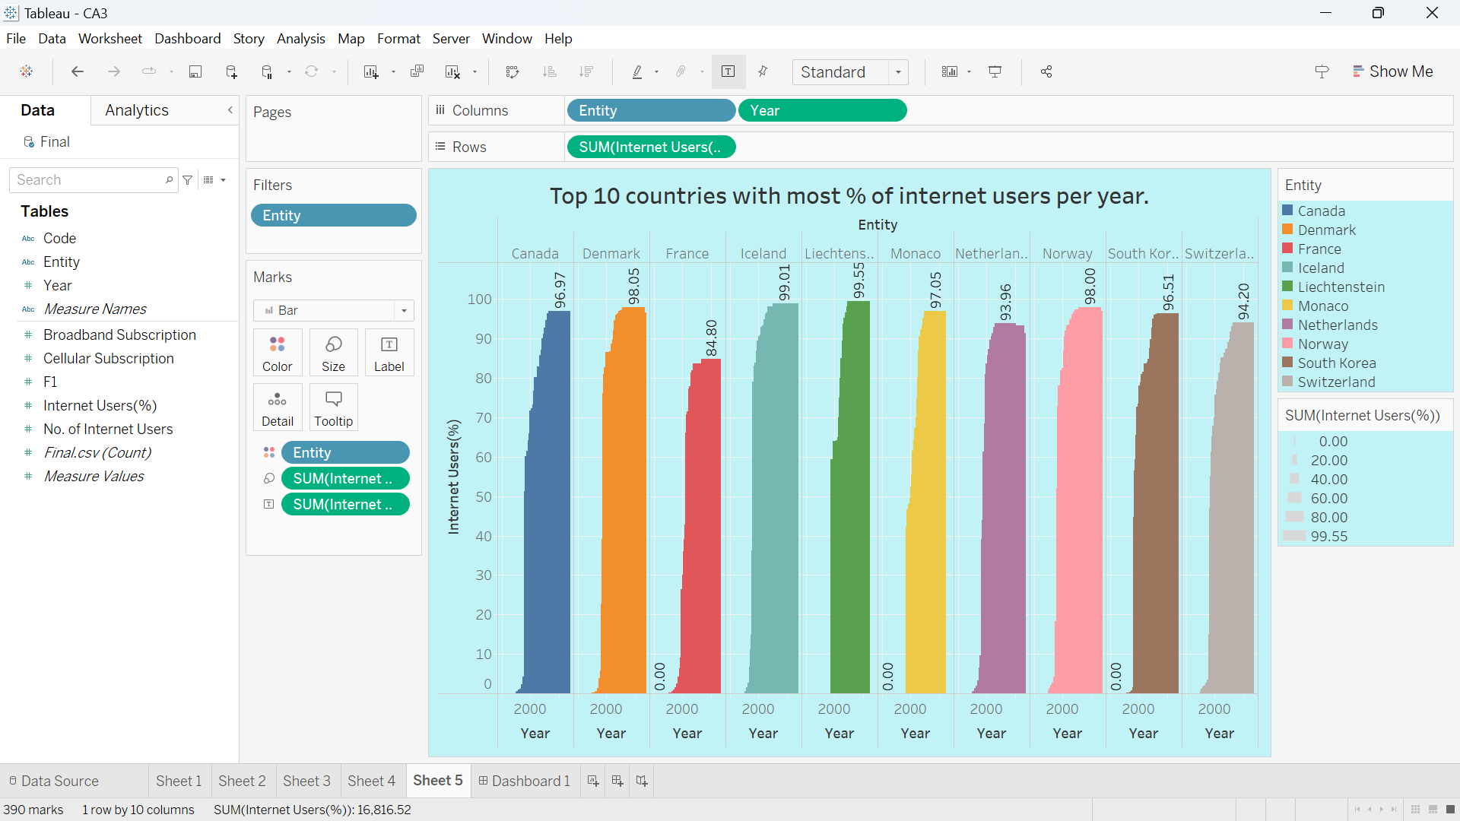

Slide 14
The Dashboard of Global Internet Users.
To better understand the data, several visualizations were created using Tableau software. Dashboard includes a variety of visualizations, including filters various charts including bar charts. The visualizations highlight trends and patterns in the data and provide a clear representation of the internet usage across different countries.

Slide 15
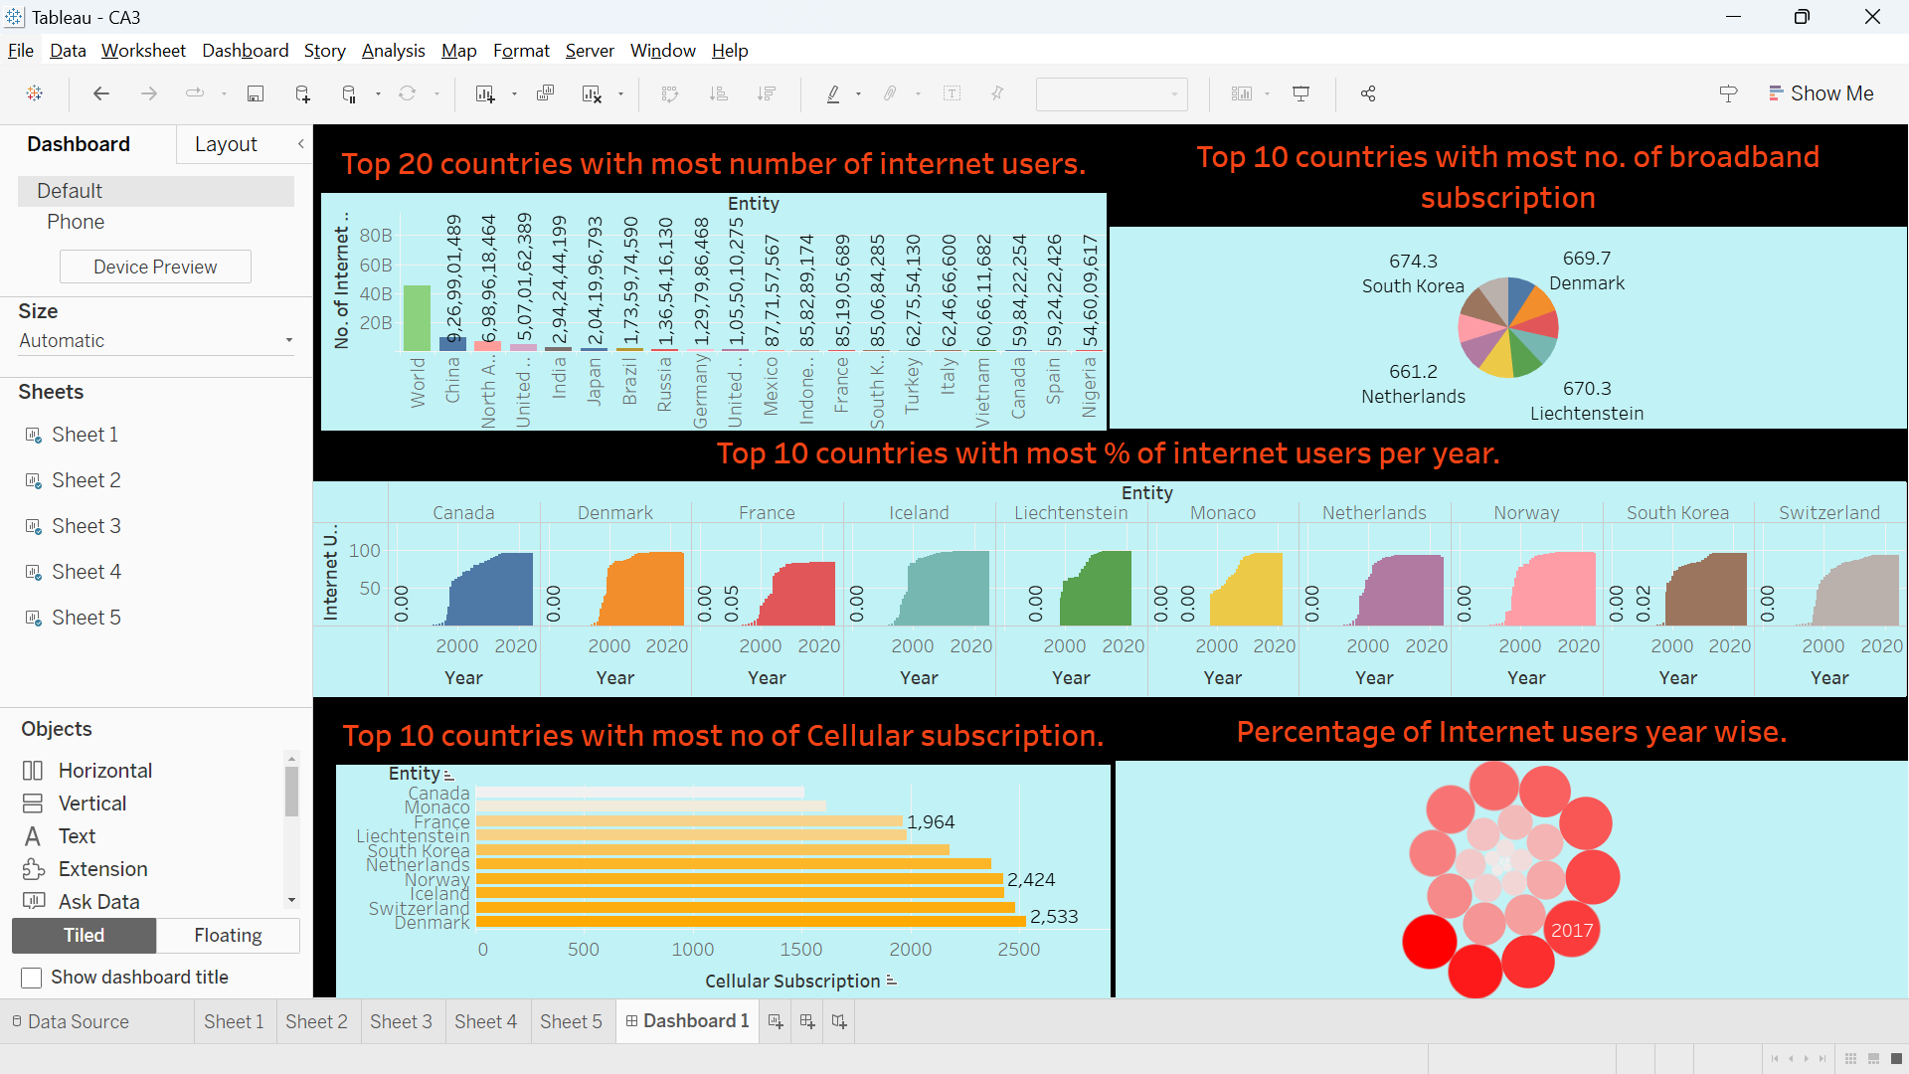

Slide 16
THANK YOU

